Slide 1
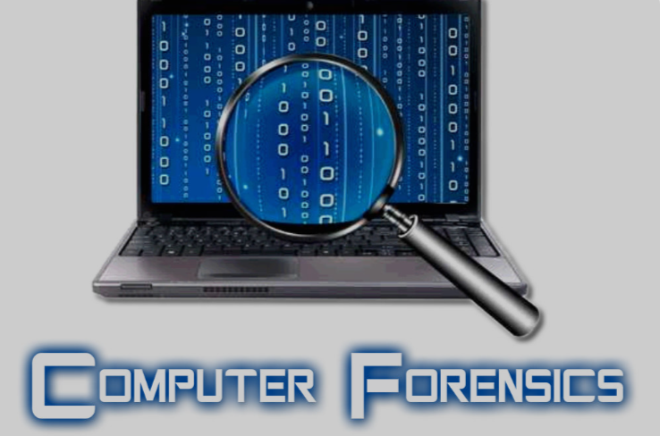
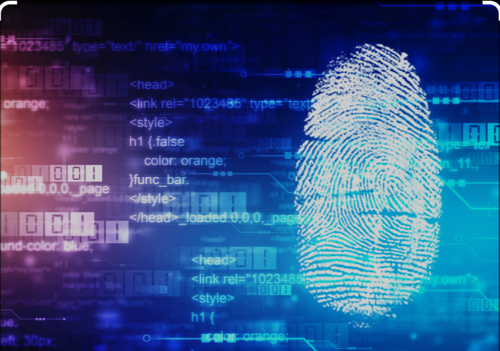
Unit-05 Understanding Computer Forensics
Dept. of CSE(CS), MSRIT

Slide 2
Computer Forensics
Introduction:-
Cyber forensics plays a role in the investigation of cybercrime.
Evidence in the case of Cyber offences is extremely important from a legal perspective.
There are legal aspects involved in the investigation as well as in the handling of the digital forensics evidence.
Technically trained and experienced experts are involved in forensics activities.
Experts use various tools and techniques to recover and analyze digital evidence including data recovery software and forensic imaging tools.
Dept. of CSE(CS), MSRIT

Slide 3
Historical Background of Cyber Forensics
The history of computer forensics can be traced back to the 1980s when personal computers became more prevalent.
Initially, computer forensics was used primarily in law enforcement investigations, but it has since expanded to include corporate investigations and civil litigation, among other areas.
The Florida Computer Crime Act was the first computer crime law to address computer fraud and intrusion in Florida in 1978.
The application of the computer for investigating computer-based crime has led to the development of a new field called computer forensics or digital forensics.
Forensics means a "characteristic of evidence that satisfies its suitability for admission as fact and it persuades based upon proof.
Forensics science is ultimately defined by use in court.
Dept. of CSE(CS), MSRIT

Slide 4
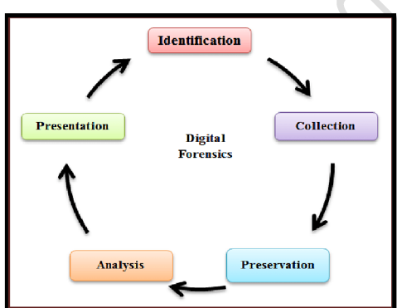
Historical Background of Cyber Forensics
Dept. of CSE(CS), MSRIT

Slide 5
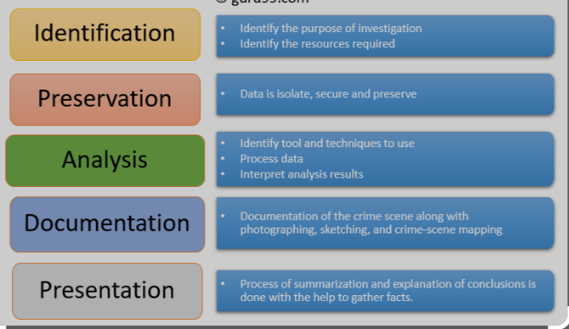
Cyber Forensics
Dept. of CSE(CS), MSRIT

Slide 6
What is the difference between Cyber security and Computer Forensics?
Cybersecurity focuses on protecting computer systems and networks from unauthorized access, theft, and damage. For example, to prevent cyber attacks, implementing security measures such as firewalls, antivirus software, and intrusion detection systems helps protect computer systems.
On the other hand, computer forensics involves investigating and analysing digital evidence to uncover the causality of a cyber attack or other computer-related offense. This includes collecting and maintaining data, analysing it to identify the origin of the attack, and presenting results in court cases and other litigation.
While both fields are essential for protecting computer systems and data, they have different goals and require distinct skill sets.
Dept. of CSE(CS), MSRIT

Slide 7
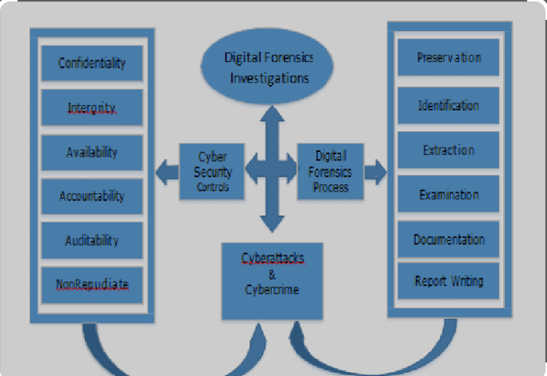
What is the difference between Cyber security and Computer Forensics?
Dept. of CSE(CS), MSRIT

Slide 8
The Role of Computer Forensics in Law Enforcement?
Computer forensics also helps identify suspects, prove guilt (or innocence), and present evidence in court.
This discipline allow investigators to recover deleted files, trace internet activity, and identify the origin of cyber attacks.
In cases of intellectual property theft, computer forensics can be used to identify the source of the theft and track stolen data.
In forgery cases, computer forensics can analyze digital documents and identify signs of tampering or manipulation.
In hacking cases, computer forensics can trace the source of the attack and identify the attacker.
Computer forensics can examine financial records and identify suspicious transactions in fraud cases.
Finally, in cases of regulatory compliance, computer forensics can ensure that companies follow the rules and regulations mandated by regulatory agencies.
Dept. of CSE(CS), MSRIT

Slide 9
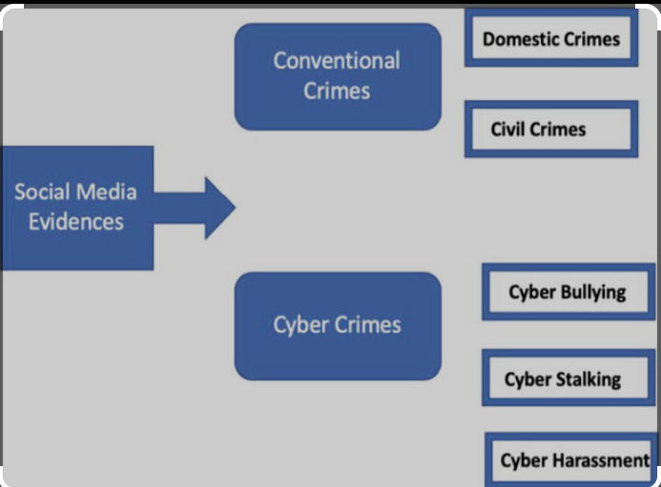
The Role of Computer Forensics in Law Enforcement?
Dept. of CSE(CS), MSRIT

Slide 10
The Role of Computer Forensics in Corporate World?
Computer forensics has become an integral tool in the corporate world for investigating and preventing cybercrime.
With the increasing reliance on technology, companies are vulnerable to various forms of cyber attacks, including intellectual property theft, data breaches, and even financial fraud.
Computer forensics experts use specialized tools and techniques to collect, analyze, and preserve digital evidence, which can improve security measures and be used in legal proceedings.
In addition, by identifying the source of a cyber attack, companies can take measures to prevent future incidents and protect their sensitive data.
As a result, computer forensics has become critical to corporate risk management, incident response, internal investigation, and cybersecurity strategies
Dept. of CSE(CS), MSRIT

Slide 11
What is Cyberforensics
Computer forensics is the application of investigation and analysis techniques to gather and preserve evidence from a particular computing device in a way that is suitable for presentation in a court of law.
The goal of computer forensics is to perform a structured investigation and maintain a documented chain of evidence to find out exactly what happened on a computing device and who was responsible for it.
Computer forensics -- which is sometimes referred to as computer forensic science -- essentially is data recovery with legal compliance guidelines to make the information admissible in legal proceedings.
The use of computer forensics isn't always tied to a crime. The forensic process is also used as part of data recovery processes to gather data from a crashed server, failed drive, reformatted operating system (OS) or other situation where a system has unexpectedly stopped working.
Dept. of CSE(CS), MSRIT

Slide 12
Cyberforensics
Cyber forensics can do the following:
It can recover deleted files, chat logs, emails, etc
It can also get deleted SMS and phone calls.
It can get recorded audio of phone conversations.
It can determine which user used which system and for how much time.
It can identify which user ran which program.
Dept. of CSE(CS), MSRIT

Slide 13
Why Cyberforensics?
Provides digital evidence of a specific or general activity
Key role in the investigation of cybercrime
Handling of the digital forensics evidence
Types of Digital Evidence:-
Persistent Data:- Remains intact when the computer is turned off. Ex:- Hard drives, disk drives and removable storage devices.
Volatile Data:- Data would be lost if the computer is turned off. Ex:- Deleted files, computer history, temp files, computer registry.
Dept. of CSE(CS), MSRIT

Slide 14
Role of Digital Forensics science
Uncover and document evidence and leads.
Corroborate evidence discovered in other ways (E-Discovery)
Assist in showing a pattern of events (data mining has an application here).
Connect attack and victim computers Reveal an end-to-end path of events leading to a compromise attempt, successful or not.
Extract data that may be hidden, deleted or otherwise not directly available.
Dept. of CSE(CS), MSRIT

Slide 15
Typical scenarios of Cyber Forensics?
Employee Internet abuse
Data leak/ data breach - unauthorized disclosure of corporate information and data (accidental and intentional);
Industrial espionage (corporate "spying" activities);
damage assessment (following an incident);
criminal fraud and deception cases;
criminals Cases (many criminals simply store information on computers, intentionally or unwittingly) and countess others;
copyright violation
Dept. of CSE(CS), MSRIT

Slide 16
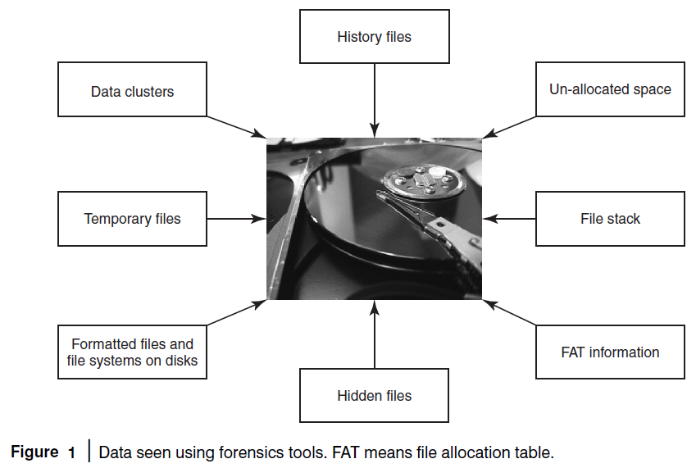
Dept. of CSE(CS), MSRIT

Slide 17
What is the difference between Forensics Policy and Security Policy?
Dept. of CSE(CS), MSRIT

Slide 18
Types of cyber forensics
Network forensics:
This involves monitoring and analysing the network traffic to and from the criminal’s network. The tools used here are network intrusion detection systems and other automated tools.
Examining network devices like routers.
Finding the packet behaviour
Comprehensive data collection:- VOIP,FTP,HTML(anything that crosses over network)
Checking for fingerprints in firewall logs, IDS/IPS, web proxies, and traffic captures.
Open source and proprietary security tools such as Wireshark, TCPDump, snort, pcap.
Dept. of CSE(CS), MSRIT

Slide 19
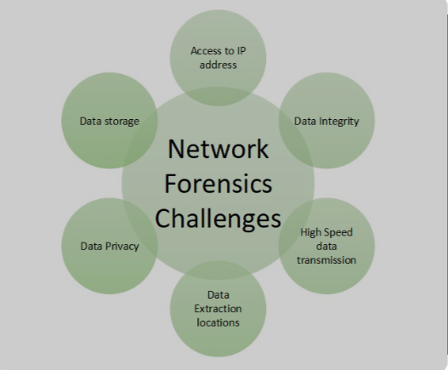
Challenges in Network Forensics
Dept. of CSE(CS), MSRIT

Slide 20
Advantages of Network Forensics
Network Forensics helps in identifying security threats and vulnerabilities
It analyses and monitors network performance demands.
Network Forensics helps in downtime.
Network resources can be used in a better way by reporting and better planning
Dept. of CSE(CS), MSRIT

Slide 21
Types of cyber forensics
Email forensics:
In this type of forensics, the experts check the email of the criminal and recover deleted email threads to extract out crucial information related to the case.
Malware forensics: This branch of forensics involves hacking-related crimes. Here, the forensics expert examines the malware, and trojans to identify the hacker involved behind this.
Dept. of CSE(CS), MSRIT

Slide 22
Types of cyber forensics
Memory forensics:
This branch of forensics deals with collecting data from the memory(like cache, RAM, etc.) in raw and then retrieving information from that data.
Analysing volatile data in the memory dump.
Memory Forensics tools
Mobile Phone Forensics:
This branch of forensics generally deals with mobile phones. They examine and analyze data from the mobile phone.
Database forensics:
This branch of forensics examines and analyzes the data from databases and their related metadata.
Disk forensics:
This branch of forensics extracts data from storage media by searching modified, active, or deleted files.
Dept. of CSE(CS), MSRIT

Slide 23
Advantages of Cyberforensics?
Cyber forensics ensures the integrity of the computer.
Through cyber forensics, many people, companies, etc get to know about such crimes, thus taking proper measures to avoid them.
Cyber forensics find evidence from digital devices and then present them in court, which can lead to the punishment of the culprit.
They efficiently track down the culprit anywhere in the world.
They help people or organizations to protect their money and time.
The relevant data can be made trending and be used in making the public aware of it.
Dept. of CSE(CS), MSRIT

Slide 24
Required skillset for cyber forensic expert
As we know, cyber forensics is based on technology. So, knowledge of various technologies, computers, mobile phones, network hacks, security breaches, etc. is required.
The expert should be very attentive while examining a large amount of data to identify proof/evidence.
The expert must be aware of criminal laws, a criminal investigation, etc.
As we know, over time technology always changes, so the experts must be updated with the latest technology.
Cyber forensic experts must be able to analyse the data, derive conclusions from it and make proper interpretations.
The communication skills of the expert must be good so that while presenting evidence in front of the court, everyone understands each detail with clarity.
The expert must have strong knowledge of basic cyber security forensics
Dept. of CSE(CS), MSRIT

Slide 25
Cyber Forensics and Digital Evidence
Cyber Forensics can be divided into two domains:
Computer Forensics
Network Forensics
A Forensics expert team brings the following additional benefits:
Technology Expertise
Forensics Methodology
Experience and efficiency
Dept. of CSE(CS), MSRIT

Slide 26
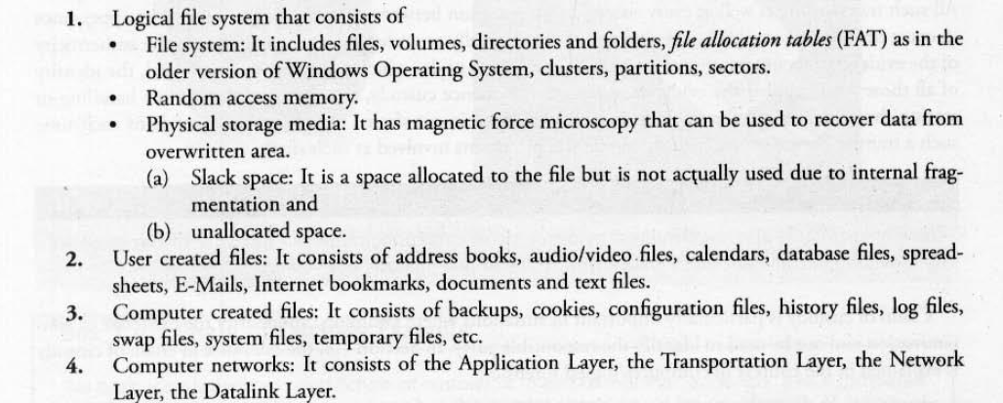
Cyber Forensics and Digital Evidence
Dept. of CSE(CS), MSRIT

Slide 27
Rules of Digital Evidence
Evidence includes:
All statements which the court permits or requires to be made before it by witnesses, in relation to matters of fact under inquiry are called oral evidence.
All documents that are produced for the inspection of the court are called documentary evidence.
Dept. of CSE(CS), MSRIT

Slide 28
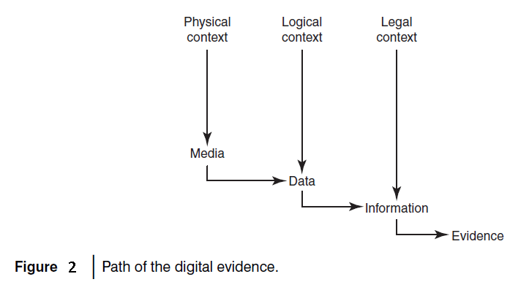
The path taken by digital evidence can be conceptually depicted as shown in Fig. 2.
Physical context:-
It must be definable in its physical form, that is , it should reside on specific piece of media
Logical Context:- It must be identifiable as to its logical position, that is, where does it resides relative to the file system.
Legal Context:- We must place the evidence in the correct context to read its meaning. This may require looking at evidence as machine language, for example, ASCII
Dept. of CSE(CS), MSRIT

Slide 29
Digital Evidence
Guidelines for digital evidence collection phase:-
Adhere to your site’s security policy and engage the appropriate incident handling and law enforcement
personnel.
Capture a picture of the system accurately as possible.
Keep detailed notes with dates and times. If possible, generate an automatic transcript. Notes and printouts should be signed and dated.
Note the difference between system clock and Coordinated Universal Time(UTC). For each time stamp provided, indicate whether UTC or local time is used.
Be prepared to testify outlining all actions you took and at what times. Detailed notes will be vital.
Minimize the changes to the data as you are collecting it. This is not limited to content changes; avoid updating file or directory access times.
Remove external avenues for change.
Dept. of CSE(CS), MSRIT

Slide 30
Digital Evidence
When confronted with a choice between collection and analysis you should do collection first and analysis later.
Procedures must be implementable. Incident response policy ,procedures should be tested to ensure feasibility.
For each device systematic approach should be adopted to follow the guidelines aid down in your collection procedure.
Proceed from volatile to the less volatile; order of volatility as follows:
Registers, cache, Routing Tables, ARP cache, process table, kernal statistics, temporary file system,disk, Remote logging and monitoring data that is relevant to the system.
Dept. of CSE(CS), MSRIT

Slide 31
RAID Levels
RAID—Redundant Array of Independent Disks
Level 0:- Striped disk array without fault tolerance
Level 1:-provides disk mirroring
Level 2:- Error-correcting codes
Level 3:-Provides byte-level stripping with a dedicated parity disk.
Level 4:- Provides block level stripping with a parity disk
Level 5: Provides data stripping at the byte level and also to stripe error correction information
Level 6:- Block level stripping with parity data distributed across all disks.
Level 7:- Adding caching to levels 3 and 4.
RAID S: Known a parity Raid.
Dept. of CSE(CS), MSRIT

Slide 32
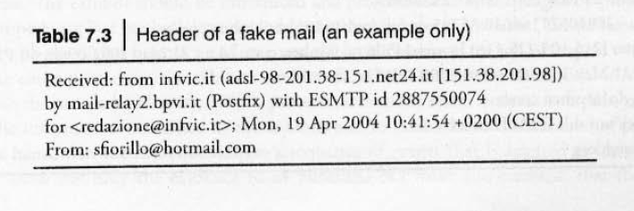
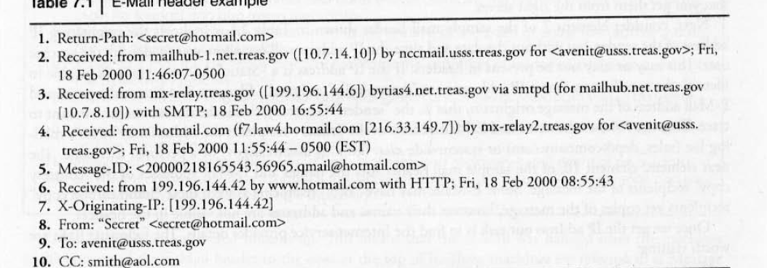
Forensics Analysis of Email
Email Header Example
Email Server
Email Gateway
Dept. of CSE(CS), MSRIT

Slide 33
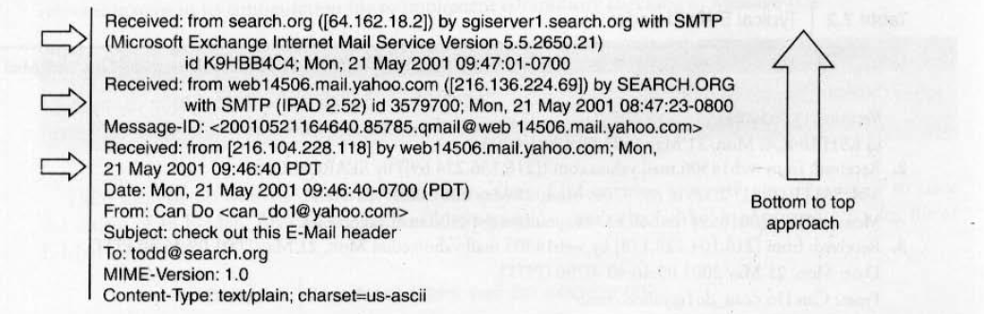
Bottom up approach to trace Email source
Dept. of CSE(CS), MSRIT

Slide 34
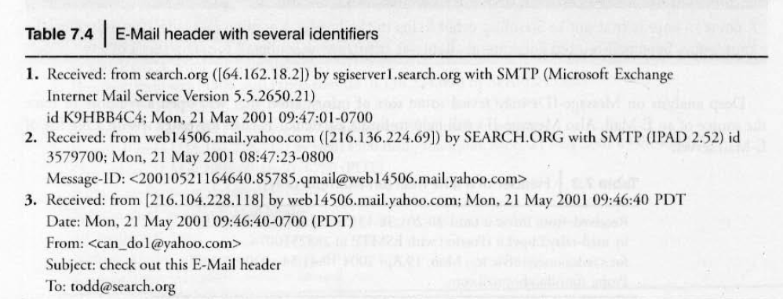
Email Analysis
Dept. of CSE(CS), MSRIT

Slide 35
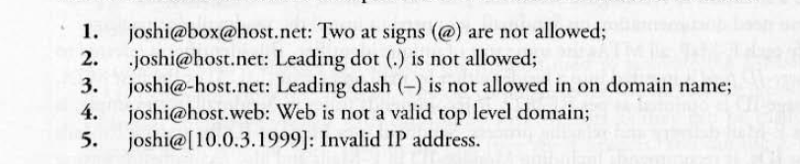
RFC2822
RFC2822 is the Internet Message Format.
Valid Email addresses:-
Dept. of CSE(CS), MSRIT

Slide 36
Digital Forensics Life Cycle
Cardinal Rules to remember are that evidence:
Is admissible
Is authentic
Is complete
Is reliable
Is understandable and believable
Dept. of CSE(CS), MSRIT

Slide 37
Phases in Computer Forensics/Digital Forensics
Preparation and Identification
Collection and Recording
Storing and Transporting
Examination/Investigation
Analysis, Interpretation and Attribution
Reporting and Testifying
Dept. of CSE(CS), MSRIT

Slide 38
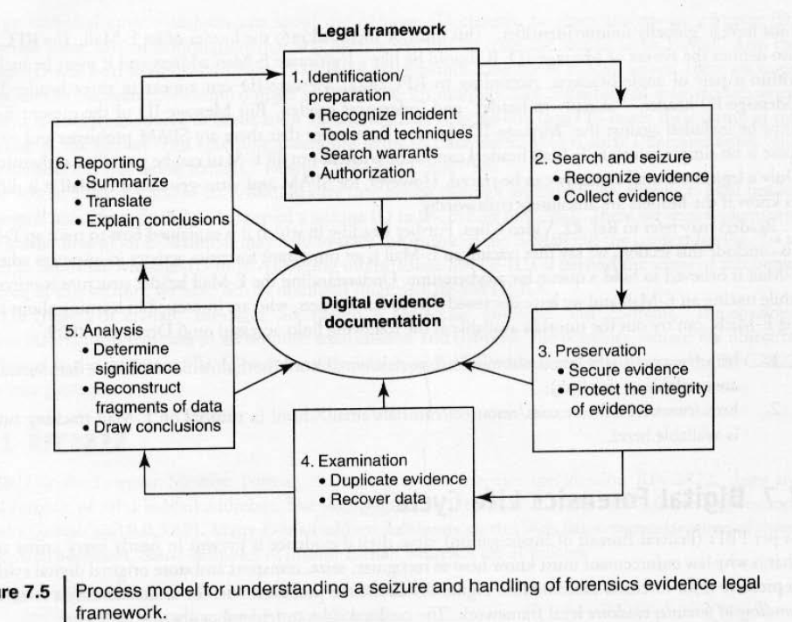
Digital Forensics Process
Dept. of CSE(CS), MSRIT

Slide 39
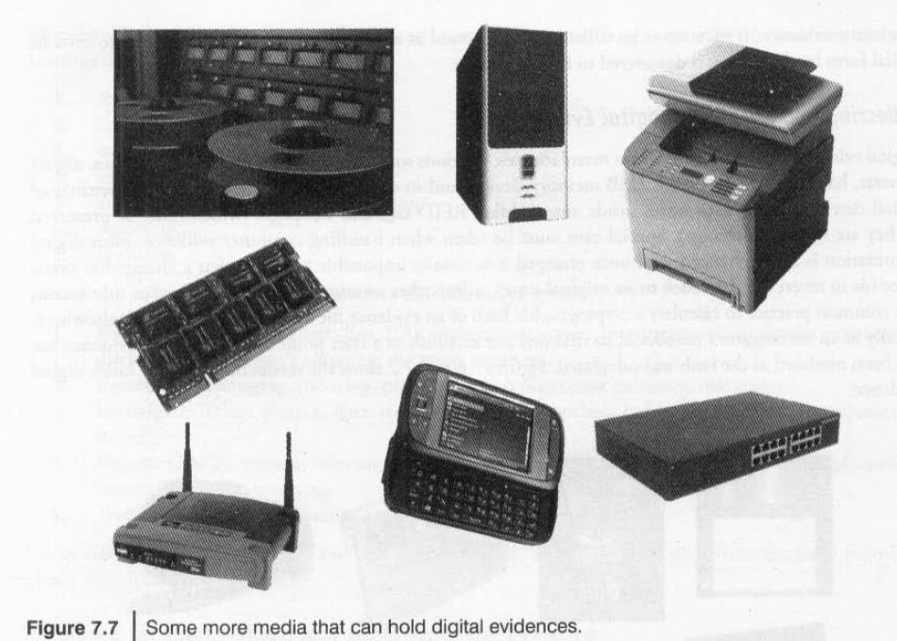
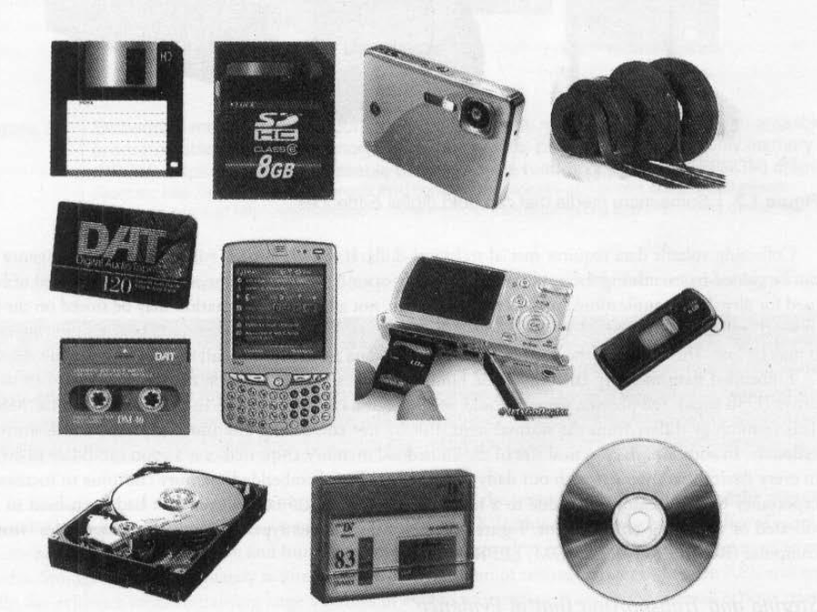
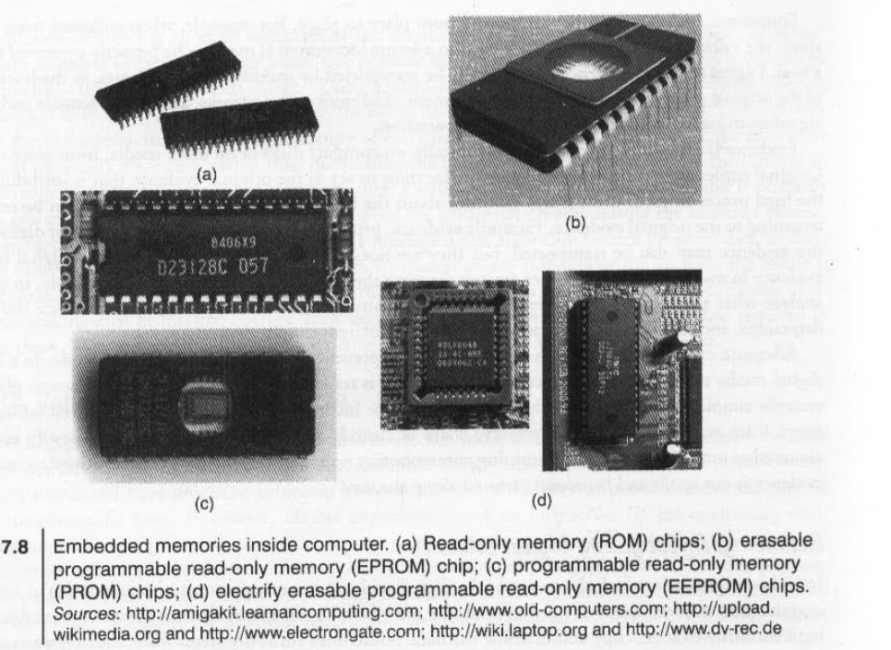
Media that can hold the digital evidences
Dept. of CSE(CS), MSRIT

Slide 40
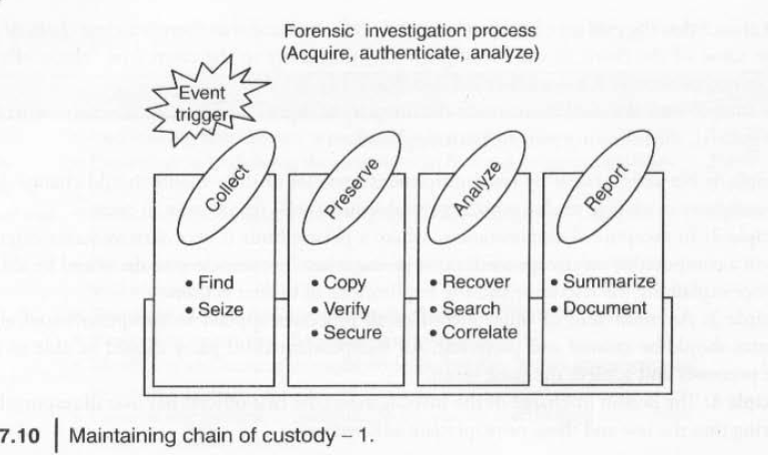
Chain of Custody(Trail or Forensic Link)
Chain of Custody refers to the logical sequence that records the sequence of custody, control, transfer, analysis and disposition of evidence in legal cases.
Dept. of CSE(CS), MSRIT

Slide 41
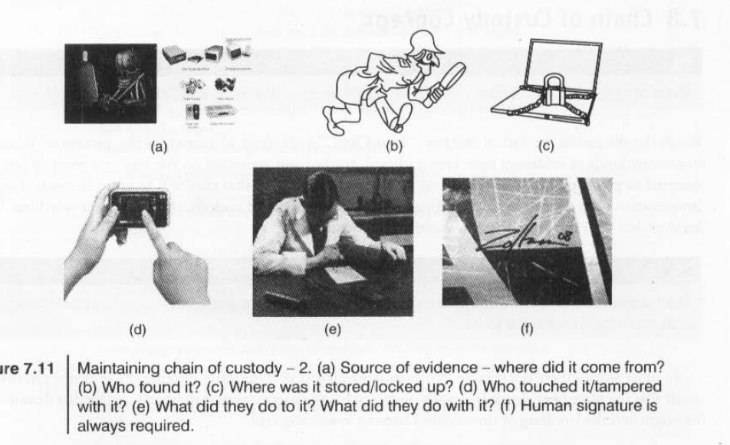
Chain of Custody
Dept. of CSE(CS), MSRIT

